Slide 1
Computer Architecture (Fall 2021)
Lecture 9
Pipelining
Dr. Yujuan Tan (谭玉娟)
Office: Main Building 0626
Email: tanyujuan@cqu.edu.cn

Slide 2
Can We Do Better?
What limitations do you see with the multi-cycle design?
Limited concurrency
Some hardware resources are idle during different phases of instruction processing cycle
“Fetch” logic is idle when an instruction is being “decoded” or “executed”
Most of the datapath is idle when a memory access is happening

Slide 3
Can We Use the Idle Hardware to Improve Concurrency?
Goal: Concurrency → throughput (more “work” completed in one cycle)
Idea: When an instruction is using some resources in its processing phase, process other instructions on idle resources not needed by that instruction
E.g., when an instruction is being decoded, fetch the next instruction
E.g., when an instruction is being executed, decode another instruction
E.g., when an instruction is accessing data memory (ld/st), execute the next instruction
E.g., when an instruction is writing its result into the register file, access data memory for the next instruction

Slide 4
Pipelining: Basic Idea
More systematically:
Pipeline the execution of multiple instructions
Analogy: “Assembly line processing” of instructions
Idea:
Divide the instruction processing cycle into distinct “stages” of processing
Ensure there are enough hardware resources to process one instruction in each stage
Process a different instruction in each stage
Instructions consecutive in program order are processed in consecutive stages
Benefit: Increases instruction processing throughput (1/CPI)
Downside: Start thinking about this…

Slide 5
The Laundry Analogy
“place one dirty load of clothes in the washer”
“when the washer is finished, place the wet load in the dryer”
“when the dryer is finished, take out the dry load and fold”
“when folding is finished, ask your roommate (??) to put the clothes away”
- steps to do a load are sequentially dependent
- no dependence between different loads
- different steps do not share resources

Slide 6
Pipelining Multiple Loads of Laundry
- 4 loads of laundry in parallel
- no additional resources
- throughput increased by 4
- latency per load is the same

Slide 7




Pipelining Multiple Loads of Laundry: In Practice
the slowest step decides throughput

Slide 8
Pipelining Multiple Loads of Laundry: In Practice
A
B
A
B
Throughput restored (2 loads per hour) using 2 dryers

Slide 9
An Ideal Pipeline
Goal: Increase throughput with little increase in cost (hardware cost, in case of instruction processing)
Repetition of identical operations
The same operation is repeated on a large number of different inputs
Repetition of independent operations
No dependencies between repeated operations
Uniformly partitionable suboperations
Processing can be evenly divided into uniform-latency suboperations (that do not share resources)
Fitting examples: automobile assembly line, doing laundry
What about the instruction processing “cycle”?

Slide 10
Ideal Pipelining
combinational logic (F,D,E,M,W)
T psec
BW=~(1/T)
T/2 ps (F,D,E)
T/2 ps (M,W)
BW=~(2/T)
T/3
ps (F,D)
T/3
ps (E,M)
T/3
ps (M,W)
BW=~(3/T)

Slide 11
More Realistic Pipeline: Throughput
Nonpipelined version with delay T
BW = 1/(T+S) where S = latch delay
k-stage pipelined version
BW_{k-stage} = 1 / (T/k +S )
BW_{max} = 1 / (1 gate delay + S )
T ps
T/k
ps
T/k
ps

Slide 12
More Realistic Pipeline: Cost
Nonpipelined version with combinational cost G
Cost = G+L where L = latch cost
k-stage pipelined version
Cost_{k-stage} = G + Lk
G gates
G/k
G/k

Slide 13
Pipelining Instruction Processing

Slide 14
Remember: The Instruction Processing Cycle
Fetch
Decode
Evaluate Address
Fetch Operands
Execute
Store Result
1. Instruction fetch (IF)
2. Instruction decode and
register operand fetch (ID/RF)
3. Execute/Evaluate memory address (EX/AG)
4. Memory operand fetch (MEM)
5. Store/writeback result (WB)

Slide 15
Remember the Single-Cycle Uarch
PCSrc₁=Jump
PCSrc₂=Br Taken
bcond
ALU operation
T
BW=~(1/T)

Slide 16
Dividing Into Stages
200ps
100ps
200ps
200ps
100ps
ignore
for now
RF
write
Is this the correct partitioning?
Why not 4 or 6 stages? Why not different boundaries?

Slide 17
Instruction Pipeline Throughput
800ps
800ps
800ps
200ps
200ps
200ps
200ps
200ps
200ps
200ps
5-stage speedup is 4, not 5 as predicated by the ideal model. Why?

Slide 18
Enabling Pipelined Processing: Pipeline Registers
No resource is used by more than 1 stage!
PC_{D}+4
PC_{E}+4
nPC_{M}
PC_{F}
A_{E}
IR_{D}
Aout_{M}
B_{E}
MDR_{W}
B_{M}
Imm_{E}
Aout_{W}
T/k
ps
T
T/k
ps

Slide 19
Pipelined Operation Example
All instruction classes must follow the same path and timing
through the pipeline stages. Any performance impact?

Slide 20
Pipelined Operation Example

Slide 21
Illustrating Pipeline Operation: Operation View
t₀
t₁
t₂
t₃
t₄
t₅
Inst₀
IF
ID
EX
MEM
WB
Inst₁
IF
ID
EX
MEM
WB
Inst₂
IF
ID
EX
MEM
WB
Inst₃
IF
ID
EX
MEM
WB
Inst₄
IF
ID
EX
MEM
IF
ID
EX
IF
ID
IF

Slide 22
Illustrating Pipeline Operation: Resource View
 | t₀ | t₁ | t₂ | t₃ | t₄ | t₅ | t₆ | t₇ | t₈ | t₉ | t₁₀
IF
ID
EX
MEM
WB
I₀
I₁
I₂
I₃
I₄
I₅
I₆
I₇
I₈
I₉
I₁₀
I₀
I₁
I₂
I₃
I₄
I₅
I₆
I₇
I₈
I₉
I₀
I₁
I₂
I₃
I₄
I₅
I₆
I₇
I₈
I₀
I₁
I₂
I₃
I₄
I₅
I₆
I₇
I₀
I₁
I₂
I₃
I₄
I₅
I₆

Slide 23
Pipelining Lessons
Pipelining doesn’t help latency of single task, it helps throughput of entire workload
Pipeline rate limited by slowest pipeline stage
Multiple tasks operating simultaneously
Potential speedup = Number pipe stages
Unbalanced lengths of pipe stages reduces speedup
Time to “fill” pipeline and time to “drain” it reduces speedup

Slide 24
Other Definitions
Pipe stage or pipe segment
A decomposable unit of the fetch-decode-execute paradigm
Pipeline depth
Number of stages in a pipeline
Machine cycle
Clock cycle time
Latch
Per phase/stage local information storage unit

Slide 25
Design Issues
Balance the length of each pipeline stage
Depth of the pipeline
Throughput =
Time per instruction on unpipelined machine
Problems
Usually, stages are not balanced
Pipelining overhead
Hazards (conflicts)
Performance (throughput CPU performance equation)
Decrease of the CPI
Decrease of cycle time

Slide 26
1st and 2nd Instruction cycles
Instruction fetch (IF)
IR Mem[PC];
NPC PC + 4
Instruction decode & register fetch (ID)
A Regs[IR_{6..10}];
B Regs[IR_{11..15}];
Imm ((IR₁₆)¹⁶ # # IR_{16..31})

Slide 27
3rd Instruction cycle
Execution & effective address (EX)
Memory reference
ALUOutput A + Imm
Register - Register ALU instruction
ALUOutput A func B
Register - Immediate ALU instruction
ALUOutput A op Imm
Branch
ALUOutput NPC + Imm; Cond (A op 0)

Slide 28
4th Instruction cycle
Memory access & branch completion (MEM)
Memory reference
PC NPC
LMD Mem[ALUOutput] (load)
Mem[ALUOutput] B (store)
Branch
if (cond) PC ALUOutput; else PC NPC

Slide 29
5th Instruction cycle
Write-back (WB)
Register - register ALU instruction
Regs[IR_{16..20}] ALUOutput
Register - immediate ALU instruction
Regs[IR_{11..15}] ALUOutput
Load instruction
Regs[IR_{11..15}] LMD

Slide 30
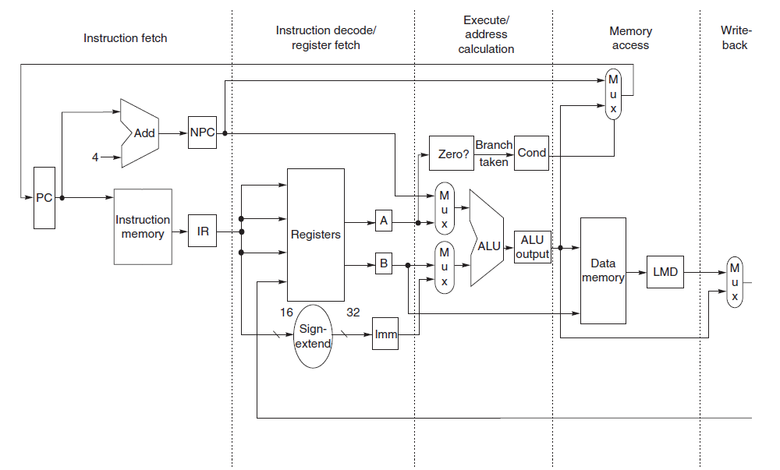
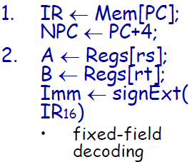
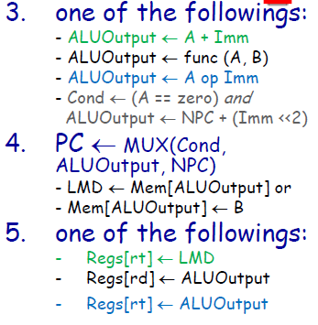
Simple Implementation of a MIPS
• temporary registers
•hold values between clock cycles for an instruction
• state elements (“visible part of the state”)
•hold values between successive instructions
• control logic (FSM or microcode controller)
• (not illustrated in the diagram above)

Slide 31
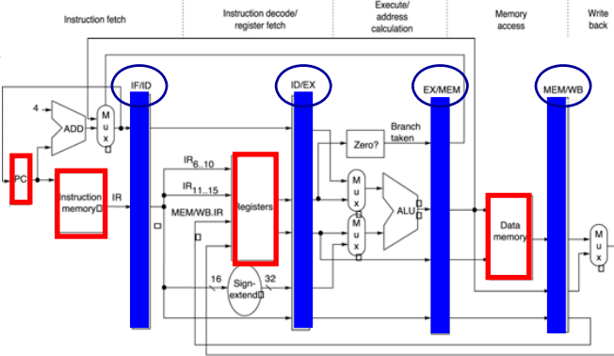
MIPS Pipeline Implementation
• Apparently easy
– each clock
cycle becomes
a pipe stage
– temporary
registers
become pipe
registers
– new instruction
issued at each
clock cycle
• Result propagation
– register value to
be stored is
read during ID
and used in MEM
– ALU result
computed during
EX (or loaded
during MEM) and
store in WB
• pipeline registers
• hold values between clock cycles for an instruction
• prevent interference (edge-triggered flip-flops)
• state elements (“visible part of the state”)
• hold values between successive instructions

Slide 32
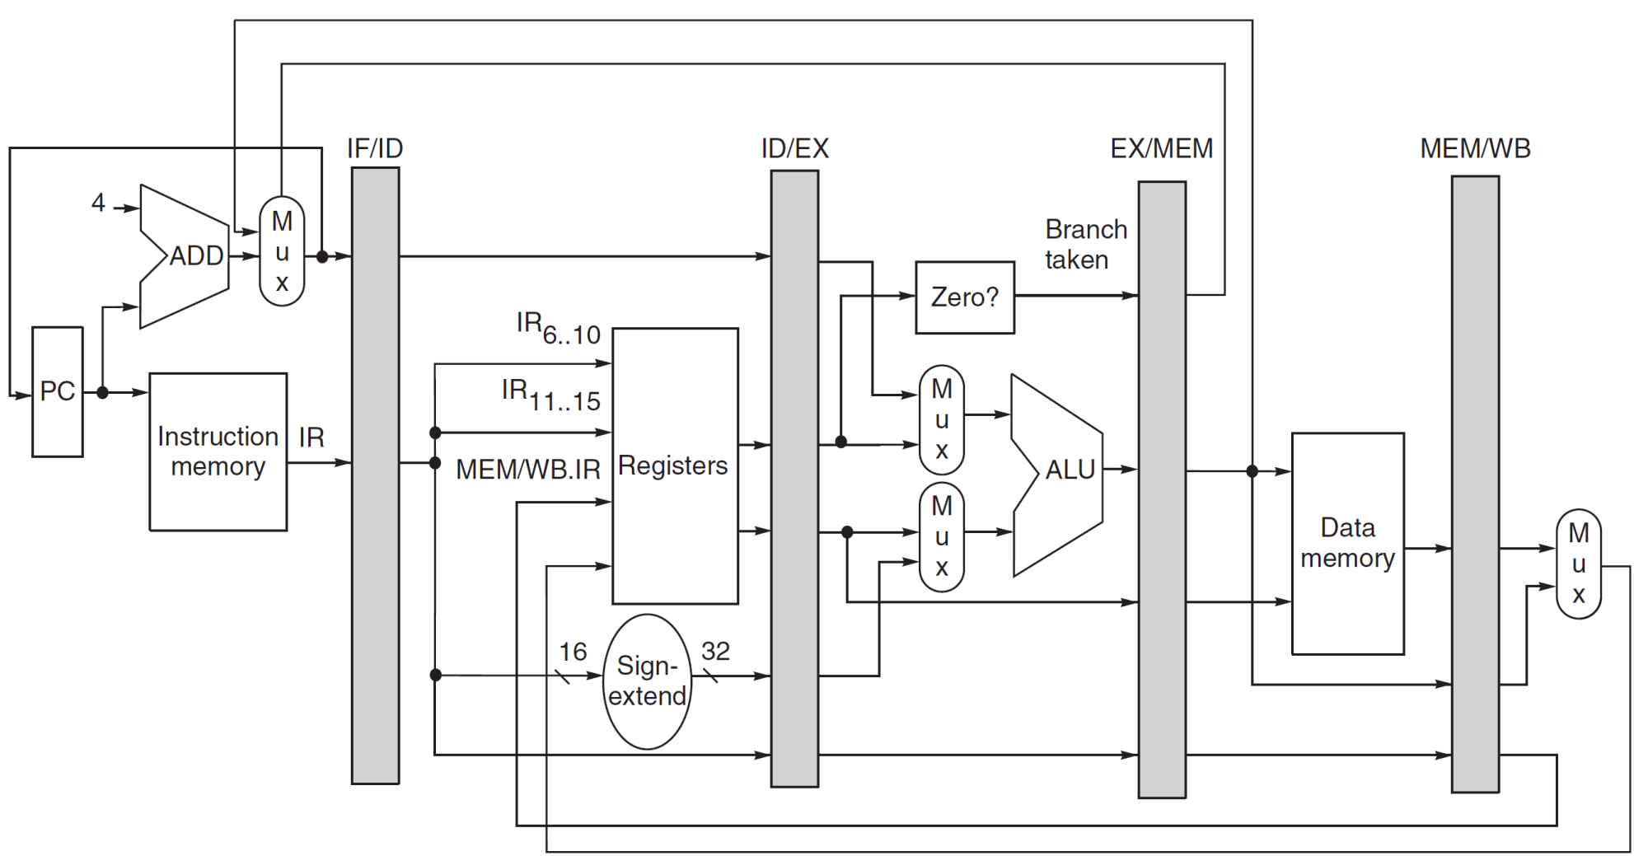
MIPS Pipeline Implementation

Slide 33
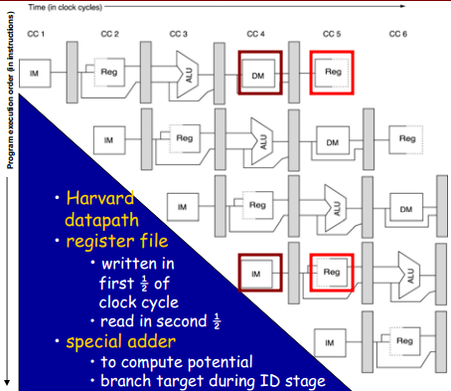
Multiple-Clock Cycle Pipeline Diagram
lw R10, 20(R1)
sub R11, R2, R3
add R12, R3, R4
lw R13, 24(R1)
add R14, R5, R6
Unlike some other speedup techniques, pipelining is fundamentally transparent to the programmer

